Slide 1
Frame Processing
Gun Automobile
Edwin Lee, Andrew Maksymowsky, William Kingsford

Slide 2
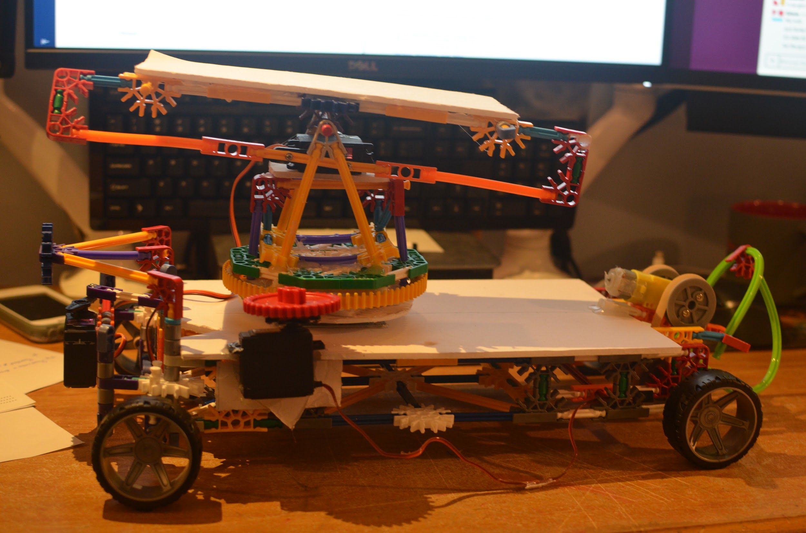
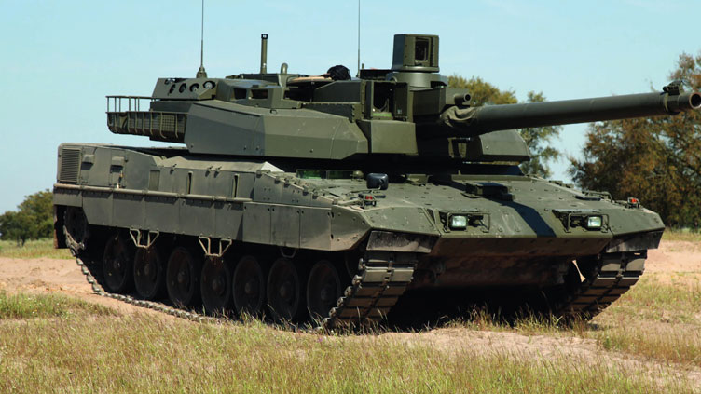
Overview
You
The guy she tells you not to worry about

Slide 3
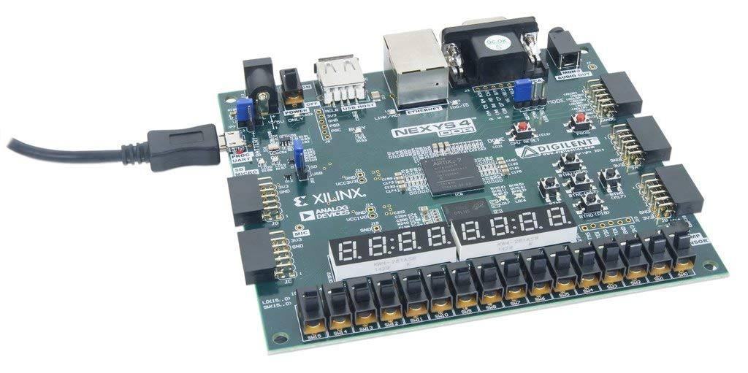
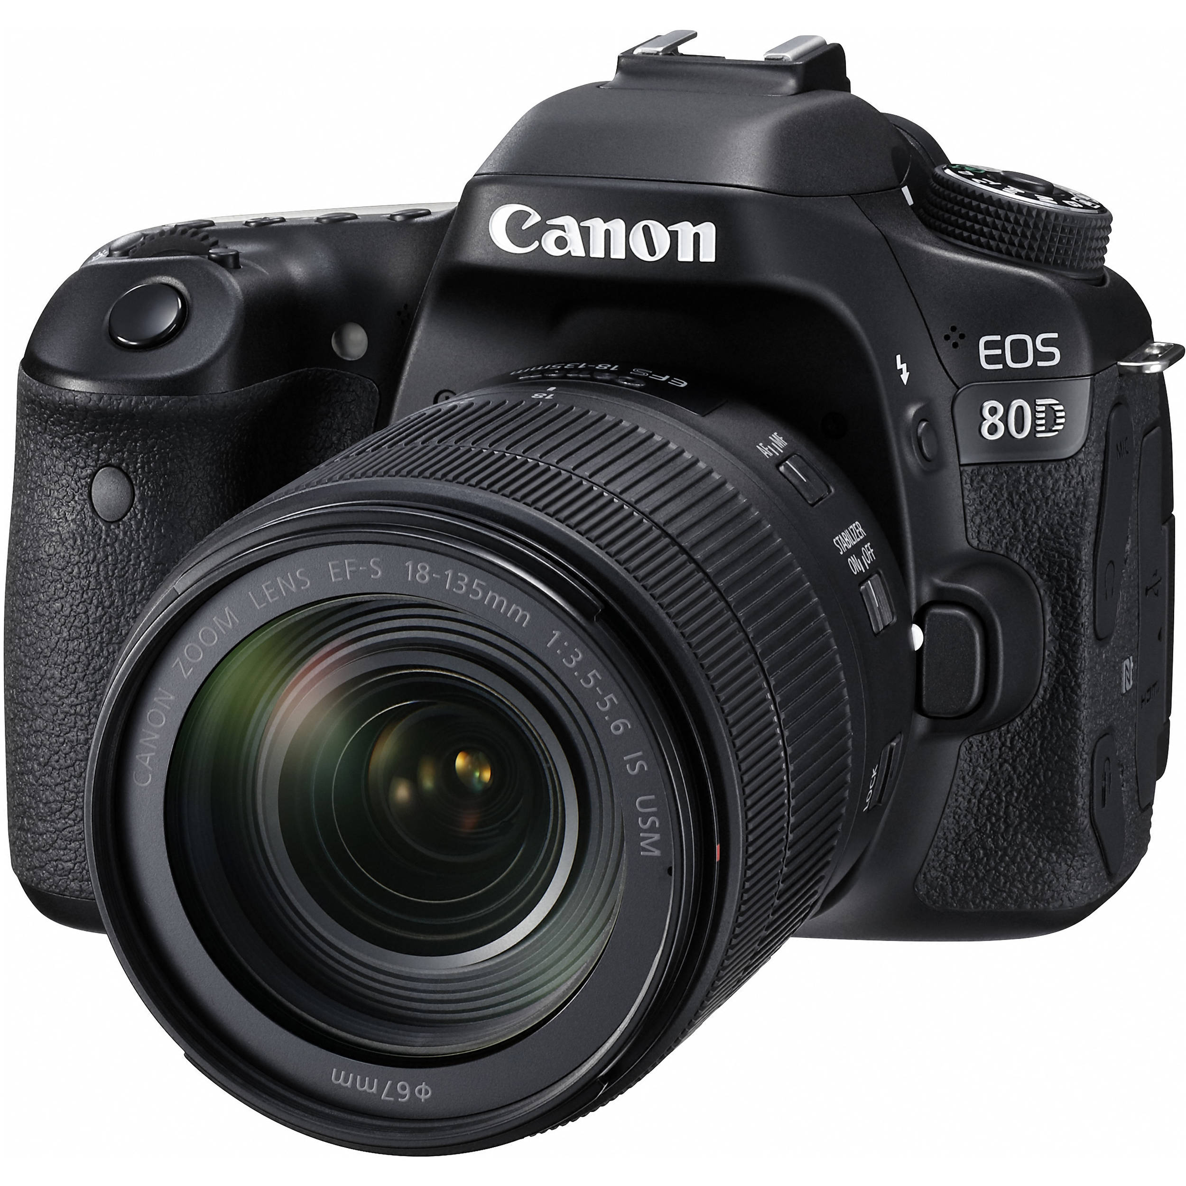
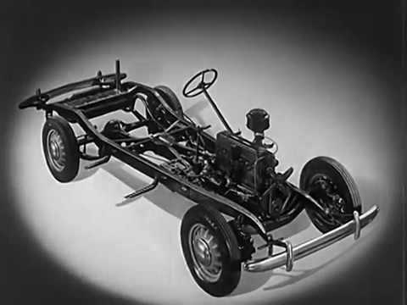

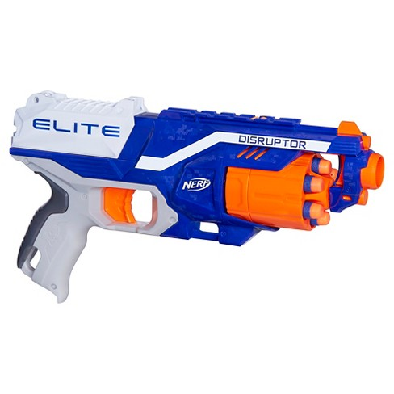

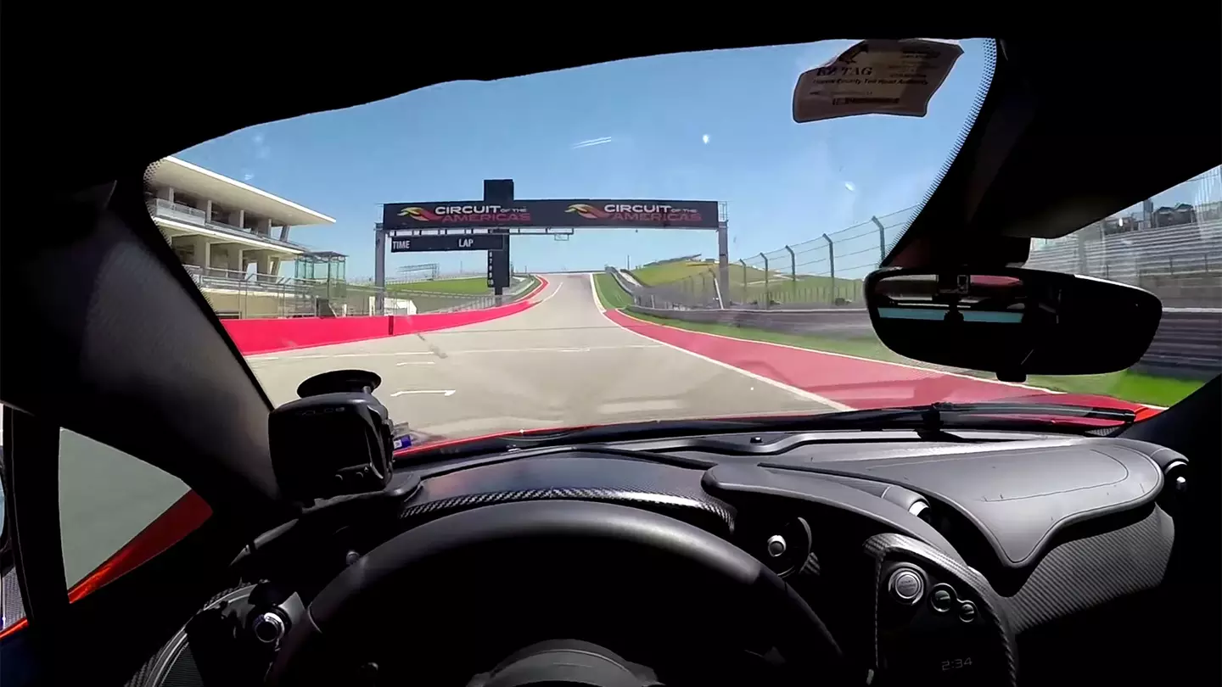

Overview - User Interface
Notes:
Inspired by Youtube
Real Time Target Identification (parallel hardware component)
Video Streaming and Remote Control over IP
Target Selection over IP

Slide 4
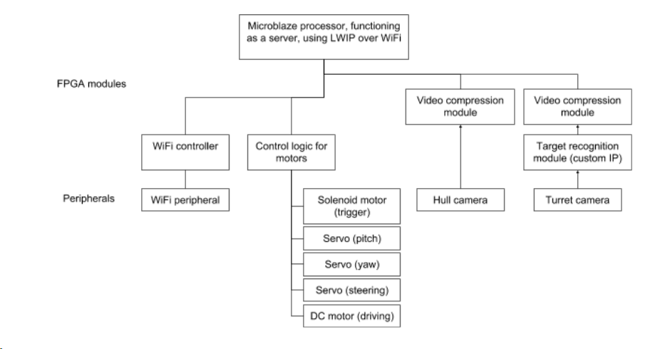
Proposed System - Block Diagram

Slide 5
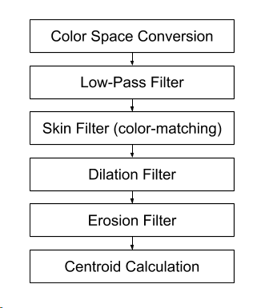
Proposed System - Custom IP

Slide 6

Example: Original Image

Slide 7
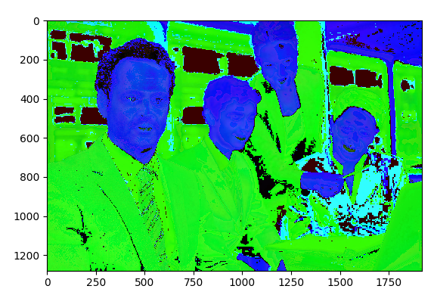
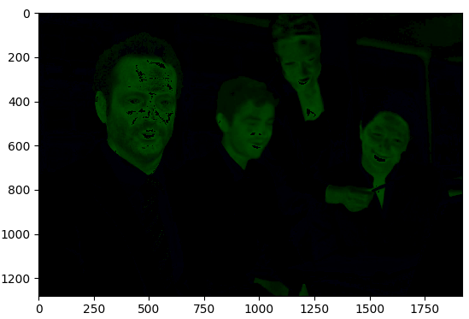
Colour Space Conversion
->
Thresholding
->

Slide 8
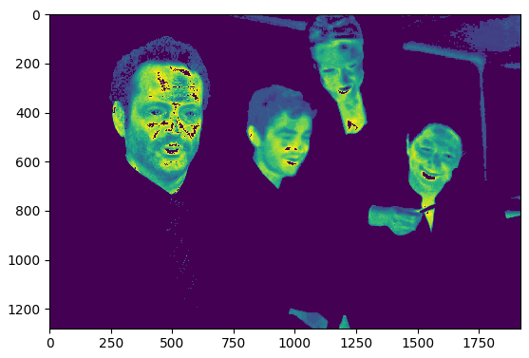
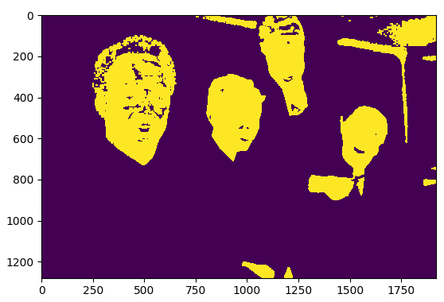
->
->
Skin Filter
Dilation Filter
->

Slide 9
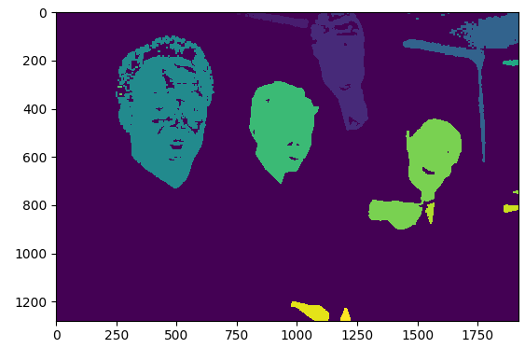
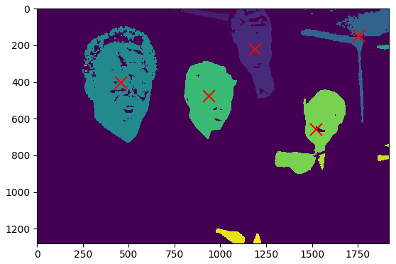
->
Erosion Filter
->
Centroid Calculation

Slide 10
Wireless Protocol
Video streaming
Two 640x480 video streams at 24fps, 12 bit colour (VGA444)
JPEG image compression for each frame, so that we don’t have to worry about dropped frames interfering with time-based interpolation
Custom, simple protocol (sending 1 frame at a time)
Bandwidth estimate: excluding control overhead and headers, we have
Each frame is 640*480*12 bits, ~10x compression ~= 46 kB, which fits into a single UDP packet
24 fps per video => ~2 MB/s
Control
Client sends value of {forward, stop, reverse} for drive motor, {left, right, straight} for steering, and {increment left/up, increment right/down, no change} for turret servos
Negligible bandwidth

Slide 11
Implementation Plan
Completed so far:
Physical vehicle construction
Target recognition IP: Software implementation in Python
WiFi UDP server working with one client
PMOD camera set up

Slide 12
Implementation Plan
Milestone 3:
Target recognition IP
Software implementation in SystemC (Andrew, Edwin)
WiFi UDP server
Streaming uncompressed, downsampled video over WiFi (Will)
Client code for driver and gunner (Will)

Slide 13
Implementation Plan
Milestone 4: (mid-project demo)
Target recognition IP
Hardware implementation (Andrew, Edwin)
WiFi UDP server
JPEG encoder IP working (Will)
Streaming compressed video over WiFi (Will)

Slide 14
Implementation Plan
Milestones 5, 6, 7:
Integration & testing

Slide 15
Testing & Integration Plan
Target recognition IP:
Implement in software first
Each pipeline stage is independent, so easier to test. Can test by writing output to VGA or bitmap
Validate WiFi server:
Dummy protocol with 2 clients
Video streaming
Predefined image
Uncompressed from PMOD
JPEG from PMOD
PMOD camera:
Display video on VGA
Stream video to client
Connect video to target recognition IP and then stream to client
Connect everything to the vehicle

Slide 16

Uncertainty & Risks
Challenges with connecting to UofT WiFi (RADIUS TACs Auth)
May be difficult having two clients at once
Bandwidth Requirements
Powering the device

Slide 17
Open Questions
Tuning parameters for the target selection
Bandwidth Demands & Video compression
Performance of mechanical systems

Slide 18
Questions?

